Slide 1



The F# Path to Relaxation
Language Design, Tools, Platforms, Community, Ecosystem, Exosystem, Openness, Cross-platform, …
Don Syme, F# Community Contributor, Microsoft Principal Researcher

Slide 2
A Gentle Stroll Through the Land of Language Design and Delivery

Slide 3
A starting position…. The great disputes of computer science should be struggled with They are chances to make a better, simpler, more relaxed world as much as create opposing camps

Slide 4
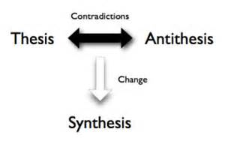
Not a new idea…

Slide 5
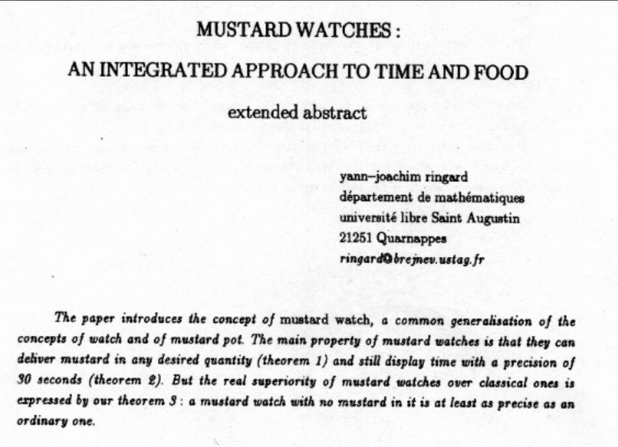
You can of course take this too far :)

Slide 6
X
Y
?

Slide 7
Functional
Interop

Slide 8
Then (2003) Functional languages were isolated, non-interoperable, using their own VMs. Interop standards like C-calls, COM, CORBA, XML were a mess for language-integration.

Slide 9
The F# Approach (also Scala, Swift, …) Embrace industry-standard runtime layers, and influence them. Keep exosystem at an appropriate distance. Design with end-to-end interop in mind. Compromise where needed.

Slide 10
Relaxation Achieved, 200% ✔ ✔ Today’s FP languages are immensely interoperable while staying true to FP principles. ✔ F# type providers raise interop to a completely new level ✖ Some tensions remain – not all functional techniques are easily implemented on industry standard VMs
Functional
Interop

Slide 11
X
Y
?

Slide 12
Enterprise
Openness

Slide 13
TL;DR – Where we are now
F# is open, cross-platform, neutral, independent
The F# Compiler Service powers many other tools
F# 4.1 now complete!
Debian, RPM and .NET Core for Linux/OSX
All F# language and tooling is accepting contributions
Fable for F#-to-Javascript
SAFE for F# fullstack
The F# community is very “self-empowered”
fsharp.org
The Visual F# Tools are Microsoft’s professional tools for Windows and Azure
Xamarin provide F# tools Android and iOS

Slide 14
F# shifted to open engineering in 2014 .NET Core shifted to open engineering in 2016 In three years, we’ve come a long way!

Slide 15
The F# Compiler – 500+ Pull Requests and rising Where to Contribute? See fsharp.github.io

Slide 16
The F# Language Design Process github.com/fsharp/fslang-design github.com/fsharp/fslang-suggestions

Slide 17
F# 4.0 ✔ True shift to cross-platform open engineering ✔ Long laundry list of language items ✔ Normalized core library ✔ Type providers more powerful ✔ Better debugging, tooling, performance ✔ ~20% compiler perf improvement
https://github.com/fsharp/fslang-design/tree/master/FSharp-4.0

Slide 18
F# 4.1 ✔ Optional large scope cycles more on this later) ✔ Result<T,Error> in standard library ✔ Unboxed (struct) tuples ✔ Unboxed (struct) records ✔ Unboxed (struct) unions ✔ Morebits and pieces
https://github.com/fsharp/fslang-design/tree/master/FSharp-4.1

Slide 19
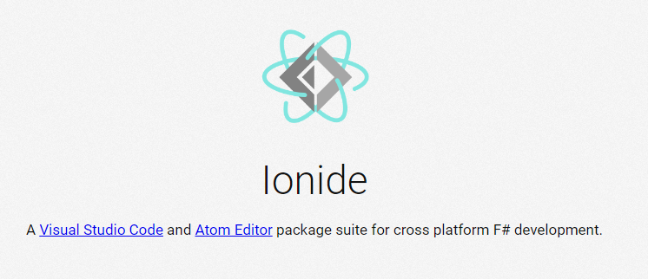
VSCode/Atom + Ionide = Cross-Platform F# Editing Love

Slide 20
F# and .NET Core (Linux, OSX, Windows) dotnet new -lang F# dotnet build docs.microsoft.com/en-us/dotnet/core/

Slide 21

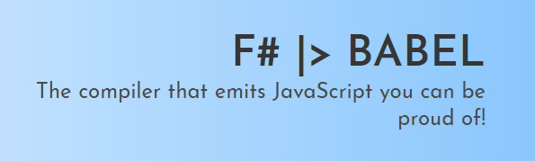
Fable! fable.io

Slide 22
.NET Core is exciting
Opens up new opportunities
Build-from-source OSS, Cross-platform
Cloud services are prioritizing support for .NET Core
Community has embraced it
Open source libraries and tooling support
Performant and supported
Ambition is to outperform all competing stacks in industry benchmarks

Slide 23
F# on .NET Core is important
F# is directly in the primary SDK
F# can stand on its own right without being tied to Windows
“If you need to target Windows, you can use F#” – no more!
Independent but aligned
F# developers are aligned with the future
Cross-platform
Cloud programming, web services, etc.
F# will benefit from future investments in Azure and .NET Core

Slide 24
F# and .NET Core is still evolving
F# Interactive isn’t yet supported, but will change
Allowing you to reference packages directly
Type Providers WIP
Some tooling and debugging issues to work out
But progress is happening fast, and the direction is clear

Slide 25
The F# Compiler Service fsharp.github.io/FSharp.Compiler.Service

Slide 26
Relaxation Achieved ✔ Enterprise Quality + Openness + Community + Tooling + Ecosystem + Evolution Path = Goodness
Enterprise
Openness

Slide 27
X
Y
?

Slide 28
Functional
Objects

Slide 29
Then (2003) In the 1990s functional languages were historically anti-OO Even today any mention of objects gives some people an “urrgghhh…” reaction. Modern Compiler Implementation with Standard ML - Chapter 14, Object Oriented Programming object – to express a dislike or distaste for something

Slide 30
F# - Objects + Functional
type Vector2D (dx:double, dy:double) =
let d2 = dx*dx+dy*dy
member v.DX = dx
member v.DY = dy
member v.Length = sqrt d2
member v.Scale(k) = Vector2D (dx*k, dy*k)
Inputs to object
construction
Object internals
Exported properties
Exported method

Slide 31
Objects
Constructed Class Types
type ObjectType(args) =
let internalValue = expr
let internalFunction args = expr
let mutable internalState = expr
member x.Prop1 = expr
member x.Meth2 args = expr
Object Expressions
{ new IObject with
member x.Prop1 = expr
member x.Meth1 args = expr }
{ new Object() with
member x.Prop1 = expr
interface IObject with
member x.Meth1 args = expr
interface IWidget with
member x.Meth1 args = expr }
Object Interface Types
type IObject =
interface ISimpleObject
abstract Prop1 : type
abstract Meth2 : type -> type

Slide 32
The F# approach is to embrace objects, make them fit with the expression-oriented typed functional paradigm especially for interop and software engineering purposes but not embrace full “object-orientation”

Slide 33
Functional
 | Expression-oriented | No null | Multiple Args = Tuples | Closure and Capture | First-class Values | Currying | HM Type Inference
void (unit) | ✓ | ✓ | ✓ | ✓ | ✓ | ✓ | ✓
Object Types | ✓ | ✓ | ✓ | ✓ | ✓ | ✓ | ✓
Subtyping | ✓ | ✓ | ✓ | ✓ | ✓ | ✓ | ✓
Dot-notation | ✓ | ✓ | ✓ | ✓ | ✓ | ✓ | ¾
Inheritance | ✓ | ✓ | ✓ | ✓ | ✓ | ✓ | ¾
Method Overloding | ✓ | ✓ | ✓ | ✓ | ¾ | ✗ | ¾
Objects
Relatively Graceful Degradation
(some type annotations needed)
Relatively Graceful Degradation
(some type annotations needed)
Some combinations outlawed for sanity

Slide 34
A functional-first approach makes a huge difference in practice fsharp.org/testimonials

Slide 35
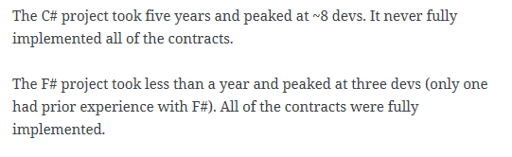
An analysis (Simon Cousins, Energy Sector)
350,000
lines of C# OO
by offshore team
30,000
lines of robust F#, with
parallel +more features
An application to evaluate the revenue due from Balancing Services contracts in the UK energy industry
http://simontcousins.azurewebsites.net/does-the-language-you-use-make-a-difference-revisited/

Slide 36
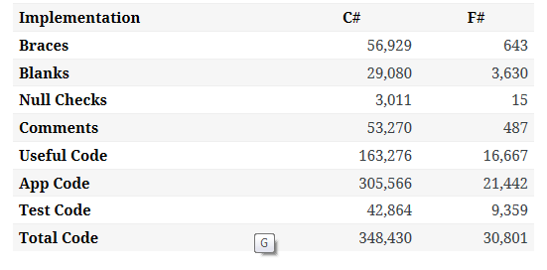

Slide 37
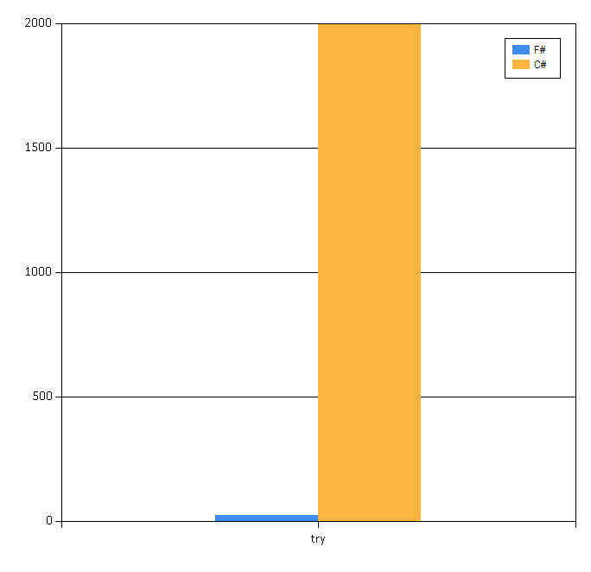

Slide 38
Simon Cousins, Energy Sector
Zero
bugs in deployed system
“F# is the safe choice for this project,
any other choice is too risky”
An application to evaluate the revenue due from Balancing Services contracts in the UK energy industry
http://simontcousins.azurewebsites.net/does-the-language-you-use-make-a-difference-revisited/

Slide 39
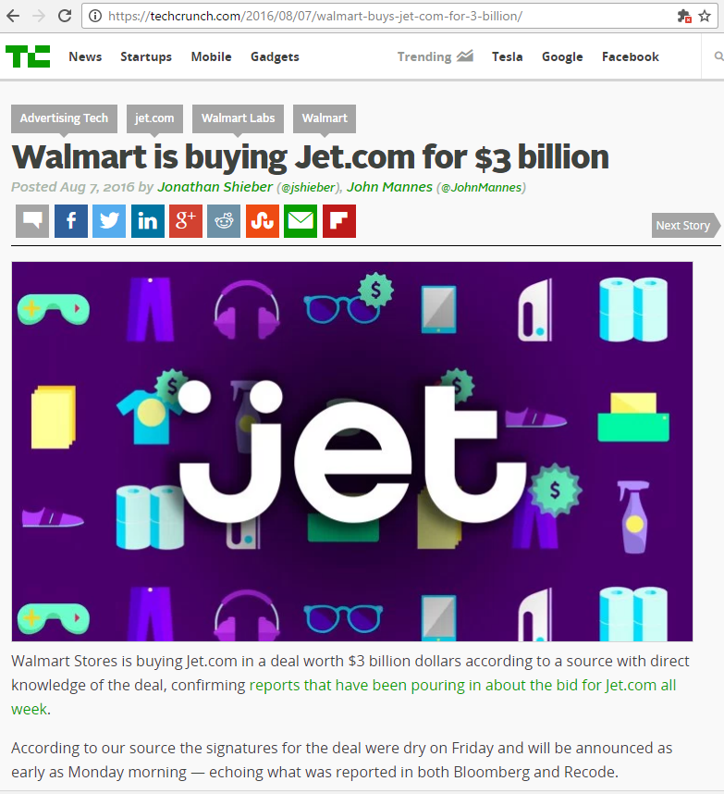
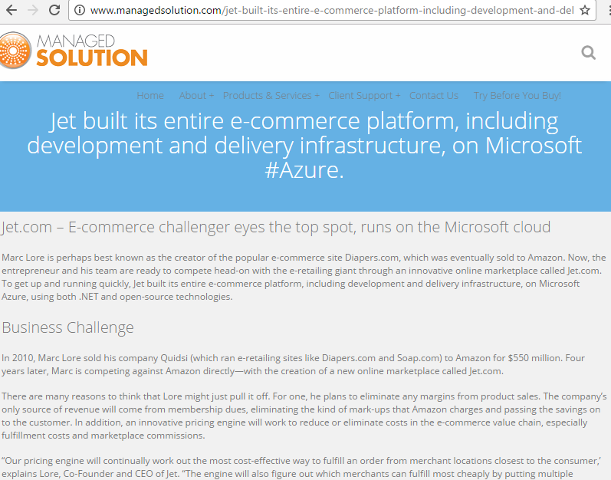
A $3B Unicorn, Built on F#

Slide 40
Positive Synthesis Achieved ✔ some limitations remain… and there is one area in particular that’s worth discussing….
Functional
Objects

Slide 41
Circularities and Modularity in the Wild (Analysis by Scott Wlaschin and F# Community)

Slide 42
Mixed OO/Functional Programming Has Won Lambdas in C#, Java, C++, … Async monadic modality in C#, Javascript, PHP (Hack), … Function types in C#, TypeScript, … Generics in C#, Java, Visual Basic, … …

Slide 43
… except where it hasn’t Inheritance everywhere!!! Nulls everywhere!!! Circularities everywhere!!!!

Slide 44
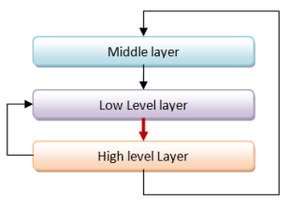
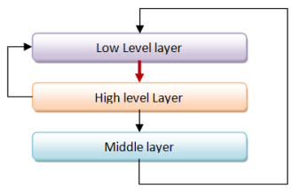
Unnecessary Circularities are Evil
To the functional programmer, it is “obvious” that our software methodology should help minimize and reduce cyclic dependencies in program structure.

Slide 45
The C# approach to circularity
All files in an “assembly” are mutually referential
Arbitrary circularity between “internal” items in an assembly
Mutually recursive “assemblies” are possible if you try hard

Slide 46
The F# approach to circularity
Like Haskell and OCaml, F# has a file ordering
F# encourages minimizing dependencies within a file
Parameterization the preferred technique
F# objects support limited forms of circularity when needed

Slide 47
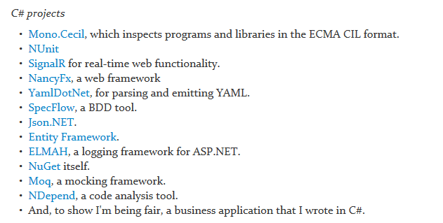
Let’s analyse some C# and F# projects

Slide 48
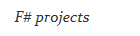
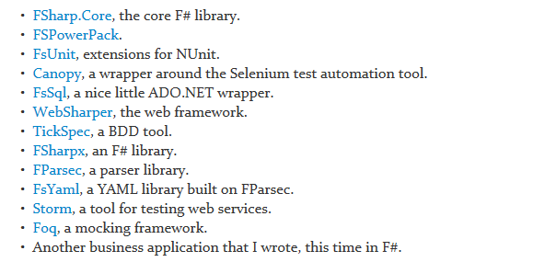
Let’s analyse some C# and F# projects

Slide 49
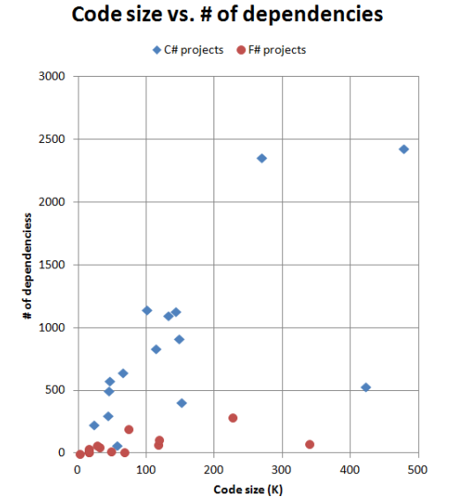
F# code has fewer top-level dependencies

Slide 50
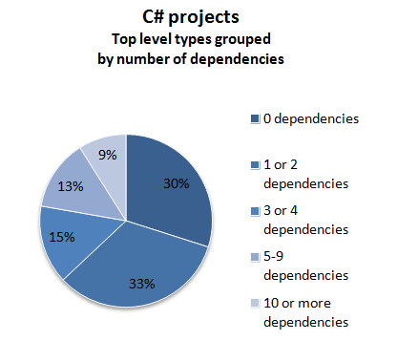
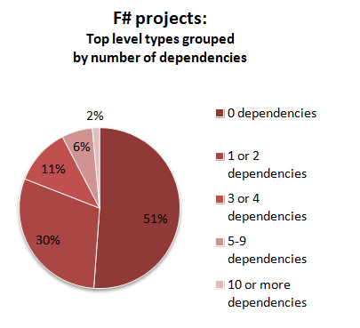

Slide 51
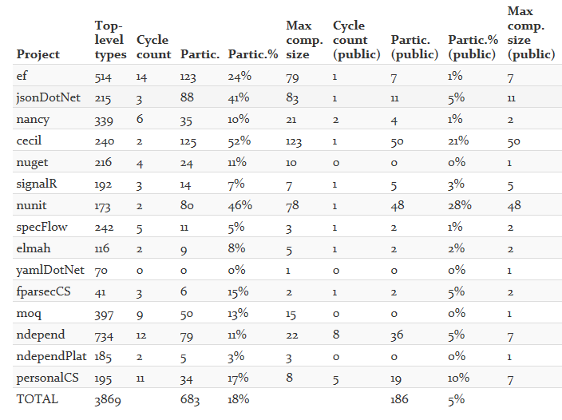

Slide 52
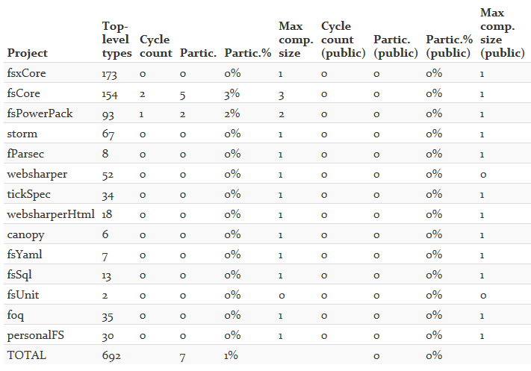

Slide 53
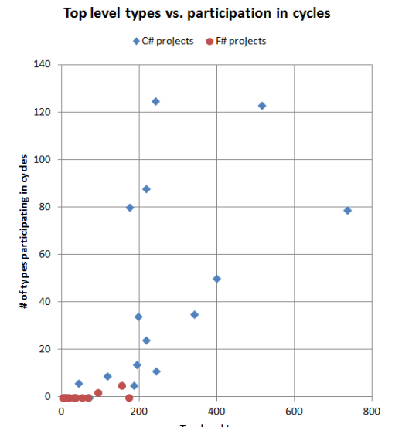
Why the difference between C# and F#?
In C#, there is nothing stopping you from creating cycles. In fact, you have to make a special effort to avoid them.
In F#, you can't easily create cycles at all.

Slide 54
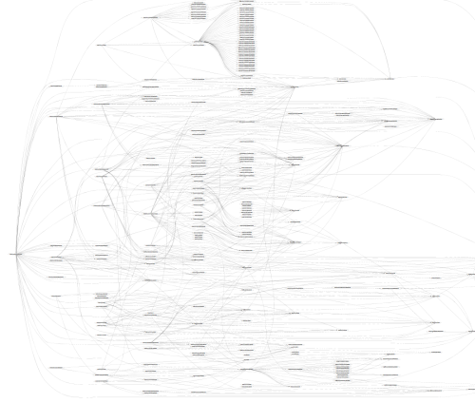
SpecFlow (C#)

Slide 55
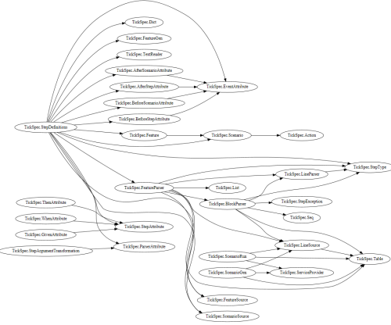
TickFlow (F#)

Slide 56
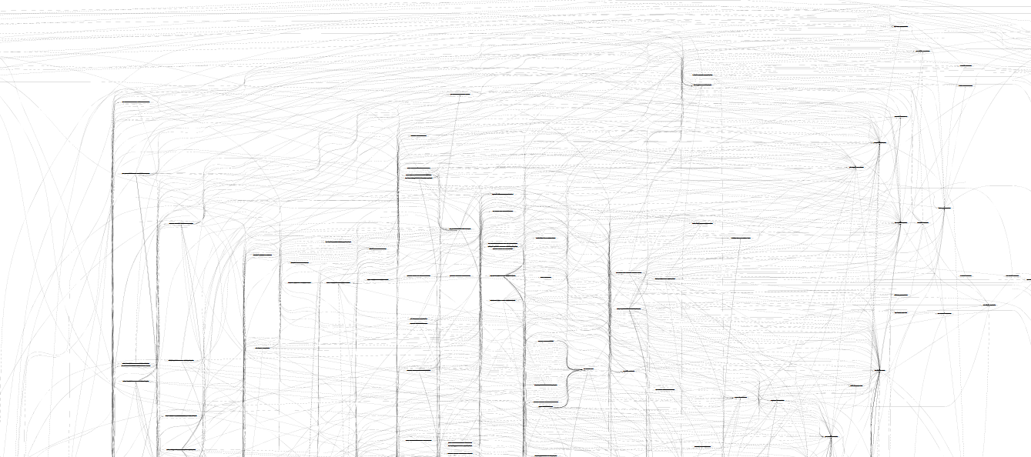
Microsoft Entity Framework
TickFlow

Slide 57
In theory and in practice, unmoderated intra-component cycles are a disaster Language mechanisms that enforce acyclicity are “good” F# assumes cyclicity for OO F# 4.1 adds optional cyclicity across large scopes There are significant unresolved tensions here in the major industrial languages

Slide 58
Pattern Matching
Abstraction

Slide 59
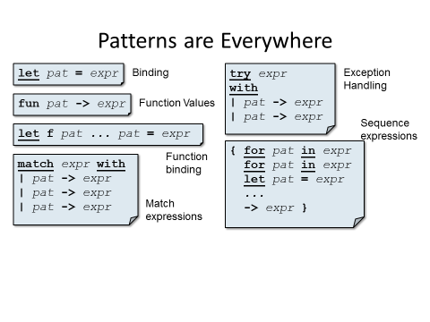
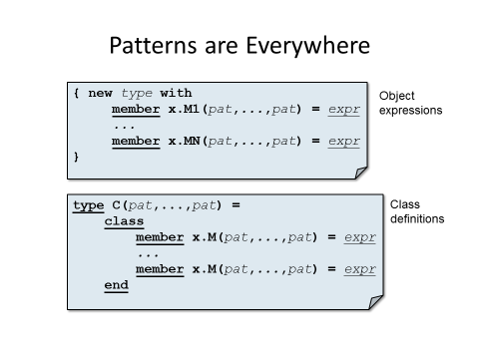

Slide 60
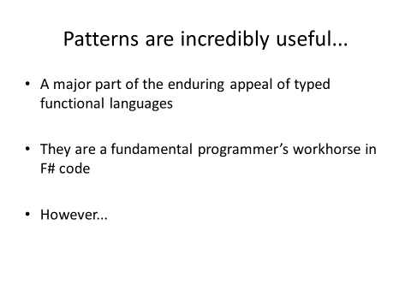
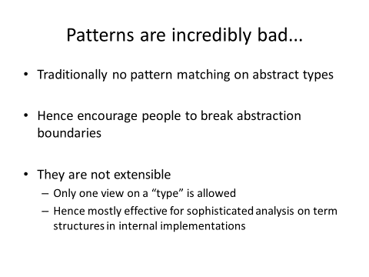

Slide 61
Enter F# Active Patterns…. (Similar to Scala extractors, designed at the same time in loose cooperation)

Slide 62
Active Patterns in F#
These tags are “active recognizer labels”
The whole function is an “active recognizer”.
Two views on complex numbers
let (|Rect|) (x:complex) = (x.Real, x.Imaginary)
let (|Polar|) (x:complex) = (x.Magnitude , x.Phase)
They are just ordinary functions with “banana names”
let mulViaPolar c1 c2 =
match c1,c2 with
| Polar(r1,th1),Polar(r2,th2) ->
CreatePolar(r1*r2, th1+th2)
let mulViaRect (Rect(ar,ai)) (Rect(br,bi)) =
CreateRect(ar*br - ai*bi, ai*br + bi*ar)
let mulViaPolar (Polar(r1,th1)) (Polar(r2,th2)) =
CreatePolar(r1*r2, th1+th2)
let mulViaRect c1 c2 =
match c1,c2 with
| Rect(ar,ai), Rect(br,bi) ->
CreateRect(ar*br - ai*bi, ai*br + bi*ar)
The use of active recognizer labels implicitly select and apply the function
(|Rect|)
(|Polar|)

Slide 63
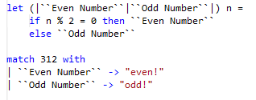

Slide 64
module BasicPatterns =
let (|Value|_|) (e:FSharpExpr) = ...
let (|Const|_|) (e:FSharpExpr) = ...
let (|TypeLambda|_|) (e:FSharpExpr) = ...
let (|Lambda|_|) (e:FSharpExpr) = ...
let (|Application|_|) (e:FSharpExpr) = ...
let (|IfThenElse|_|) (e:FSharpExpr) = ...
let (|Let|_|) (e:FSharpExpr) = ...
let (|LetRec|_|) (e:FSharpExpr) = ...
let (|NewRecord|_|) (e:FSharpExpr) = ...
let (|NewUnionCase|_|) (e:FSharpExpr) = ...
let (|NewTuple|_|) (e:FSharpExpr) = ...
let (|TupleGet|_|) (e:FSharpExpr) = ...

Slide 65
let (|IdentifierNameSyntax|_|) (n: CSharpSyntaxNode) =
match n with
| :? IdentifierNameSyntax as t -> Some(t.CSharpKind(), t.Identifier)
| _ -> None
let (|IdentifierName|_|) (n: CSharpSyntaxNode) =
match n.CSharpKind() with
| SyntaxKind.IdentifierName -> ...
| _ -> None
let (|QualifiedNameSyntax|_|) (n: CSharpSyntaxNode) =
match n with
| :? QualifiedNameSyntax as t -> ...
| _ -> None
let (|QualifiedName|_|) (n: CSharpSyntaxNode) =
match n.CSharpKind() with
| SyntaxKind.QualifiedName -> ...
| _ -> None

Slide 66
Relaxation Achieved ✔ An extremely useful mechanism that greatly expands the utility of pattern matching in the language while allowing abstraction Don’t leave home without them
Pattern Matching
Abstraction

Slide 67
Code
Data
In one large company, ~500 people work on tooling for this
…and 5000+ people work on tooling for this

Slide 68
We are living through an information revolution

Slide 69
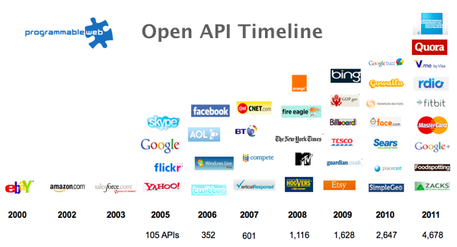
The Information Revolution
2012
2013
6,432
10,537

Slide 70
We need to bring information into the language… At internet-scale, strongly tooled, strongly typed

Slide 71
Paradigm Locator
Statically Typed
Dynamically Typed
Options
make statically typed langs more dynamic
make dynamically typed langs more static
apply moderated static typing much more broadly

Slide 72
http://fsharp.github.io/FSharp.Data/images/csv.gif http://fsharp.github.io/FSharp.Data/images/wb.gif

Slide 73
Enter F# Type Providers…. “Just like a library” “A design-time component that computes a space of types and methods on-demand…” “An adaptor between data/services and the .NET type system…” “On-demand, scalable compile-time provision of type/module definitions…”

Slide 74

Theme #1 - Many Data Sources, One Mechanism
Segoe UI Light
types

Slide 75
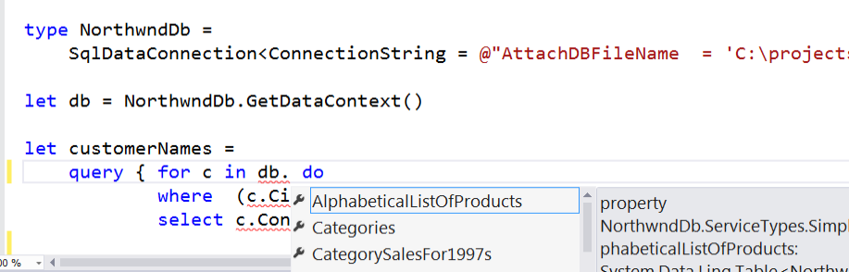
SQL #1

Slide 76
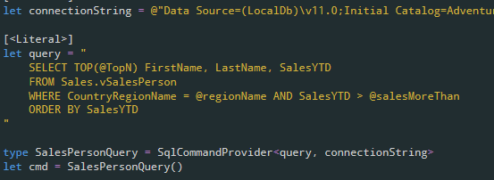
SQL #2

Slide 77
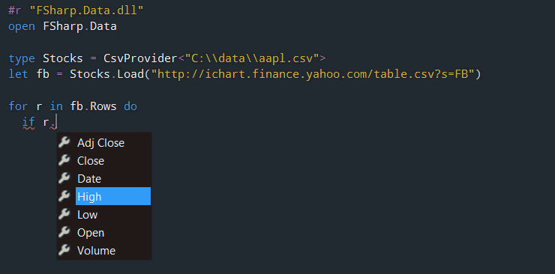
CSV

Slide 78
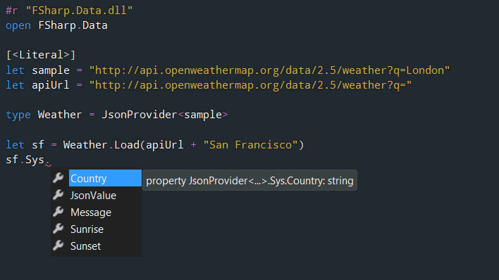
JSON

Slide 79
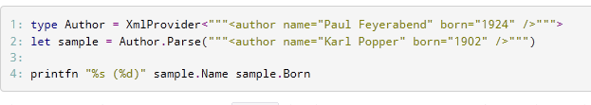
XML

Slide 80
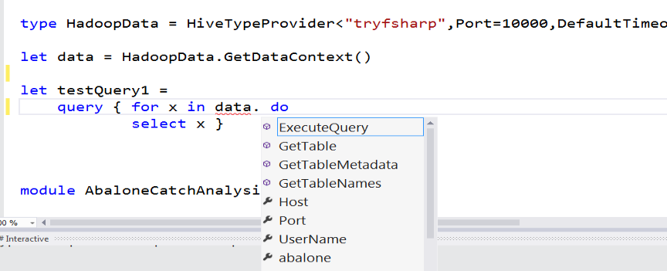
Hadoop/Hive

Slide 81
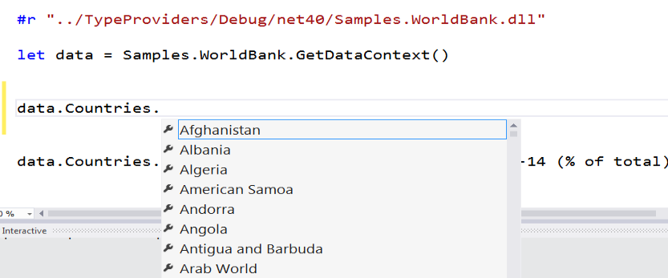
Web APIs

Slide 82
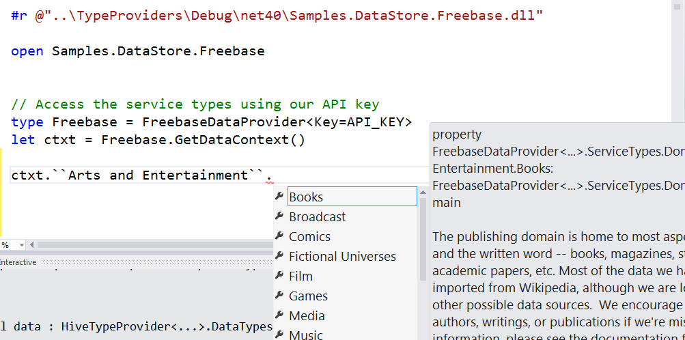
Entity Graphs

Slide 83
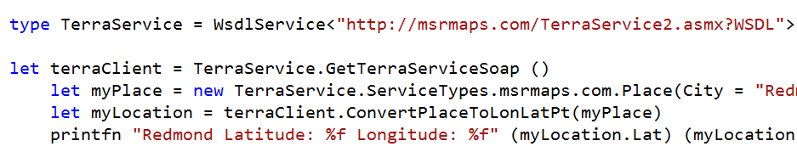
WSDL

Slide 84
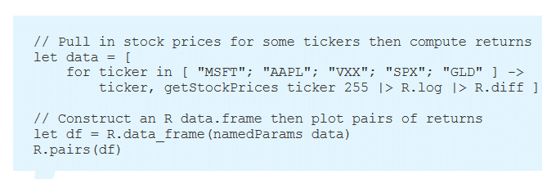
R

Slide 85
Theme #2 - Data at Multiple Scales
From Everything to Individuals
Data Scripters need to work with different granularities of schematization
data.AllEntites
data.Automotive.``Automobile Models``
data.Automotive.``Automobile Models``.Individuals.``Porsche 911``
…Only a language that supports massively scalable metadata can operate at all these levels
Every stable entity can get a unique type

Slide 86
“The idea of integrating internet-scale information services directly into the program's variable and type space is probably the most innovative programming language idea I’ve heard of in a decade” (Jim Cordy, Queens U) Overly kind, but thought provoking!

Slide 87
Relaxation Achieved ✔ ✔ F# Type Providers have been a hugely successful feature – their range of useful application is enormous. They bring data and typed programming into synthesis like no other feature around
Code
Data

Slide 88
X
Y
?

Slide 89
Sync
Async

Slide 90
Numbers
Numbers-with Units

Slide 91
http://fsharp.org/use/gpu ✔
GPU
CPU
Alea GPU

Slide 92
What’s Ahead? Well, for me, many areas of tension in “upstack” language design have been resolved But there are still some areas that bug me...

Slide 93
http://m-brace.net
REPL
Distribution and Scale
?

Slide 94
Type Providers
Cross-compilation
?
e.g. My recent work on F# Type Provider SDK

Slide 95
Type-classes
Object-orientation
?
e.g. Recent work preparing for F# 4.2 (note, not full type classes by any means!)

Slide 96
In Conclusion!
Functional
Objects
Sync
Async
Code
Data
Open
Enterprise
…
…
Opposites come in all shapes and flavours
Achieving simplicity and relaxation is key ☺
Synthesis from contradiction is at the heart of applied PL design

Slide 97
Thank you!! Questions?

